Slide 1
Energy around us
Scuola primaria di Suello
Classe V

Slide 2
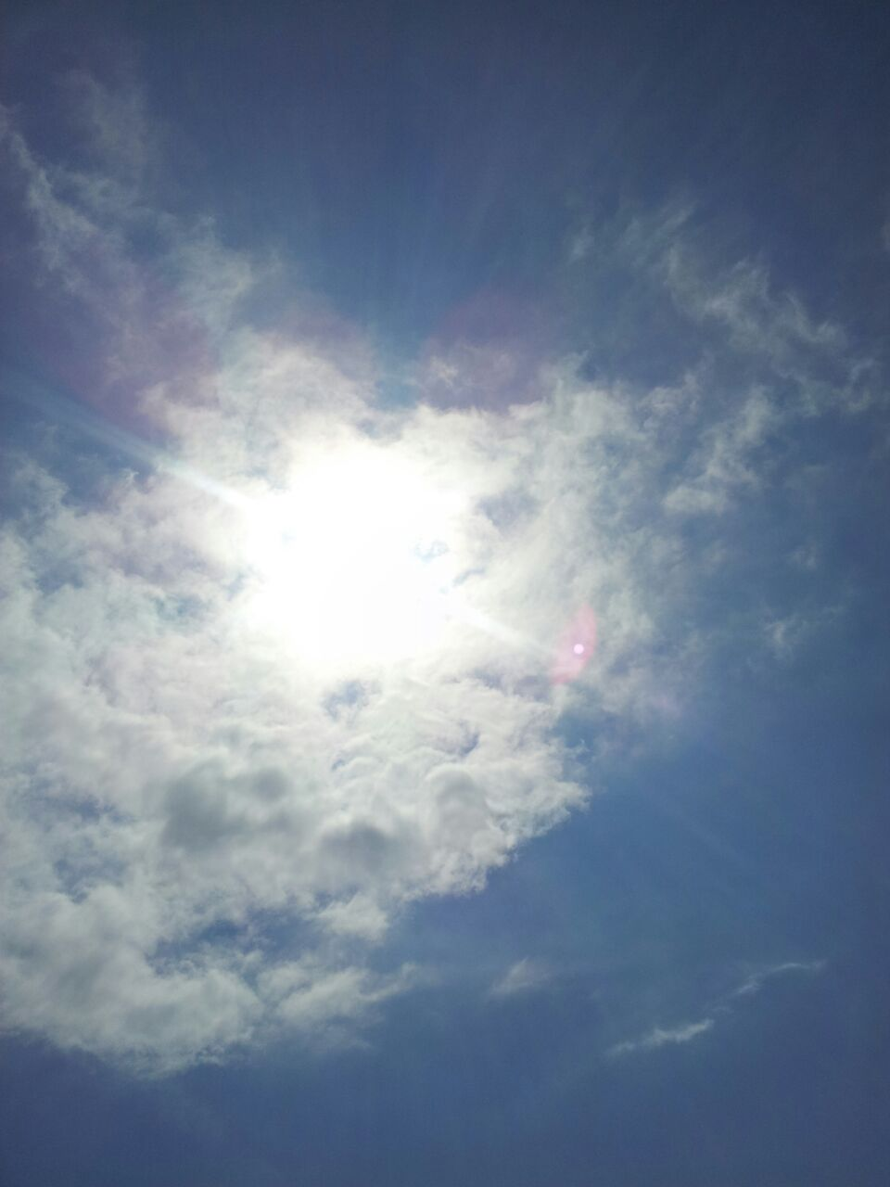
What is energy?

Slide 3
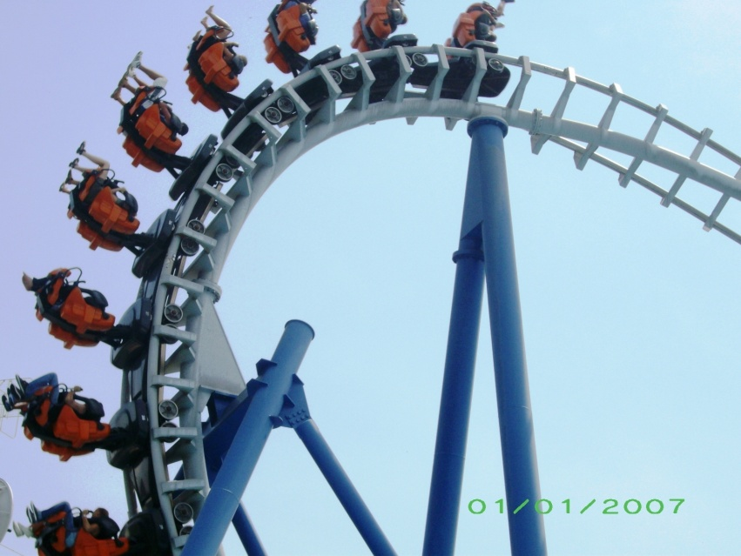
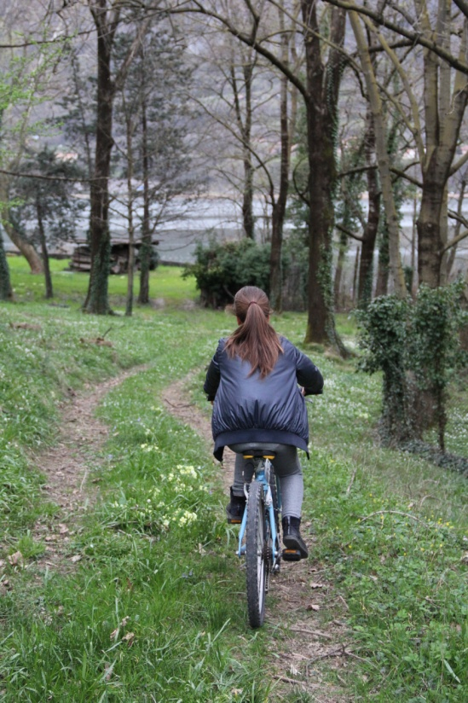
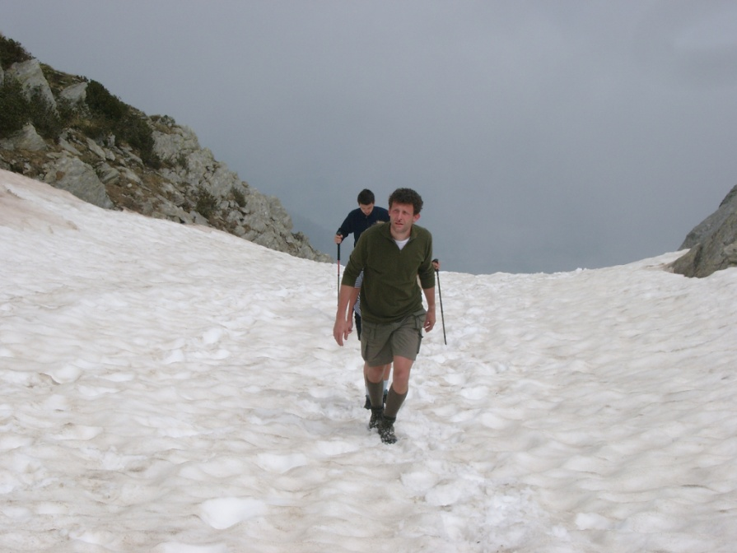
Energy is the ability to do work

Slide 4
The sun is the most important source of energy

Slide 5
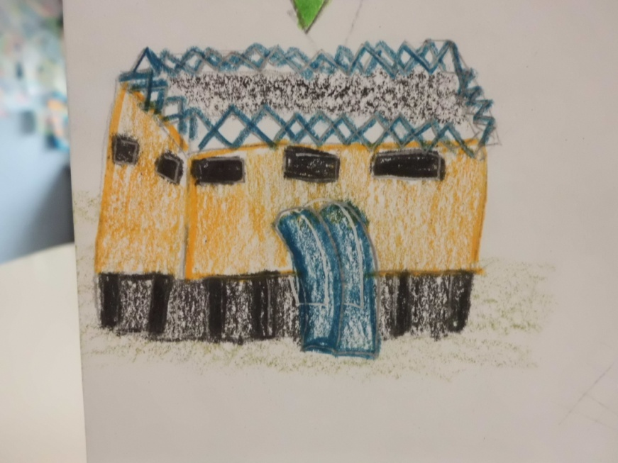
Electricity
Hydropower

Slide 6
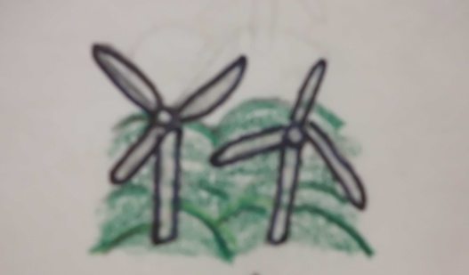
Eolic
Solar

Slide 7
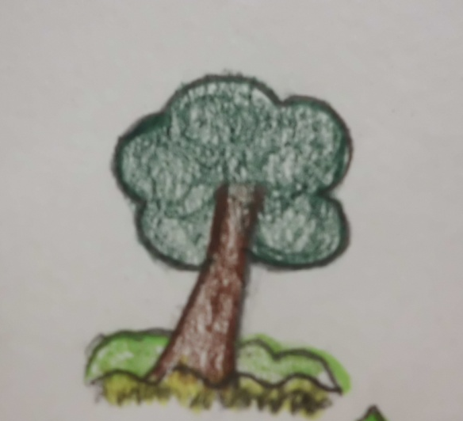
Solar
Petroleum
Chemical
Coal

Slide 8
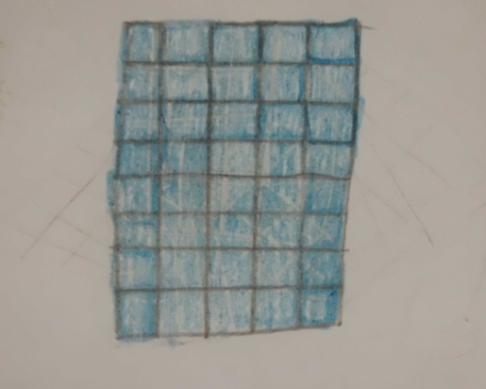
Solar
Solar cell

Slide 9
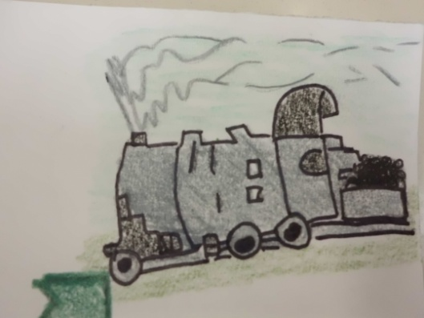
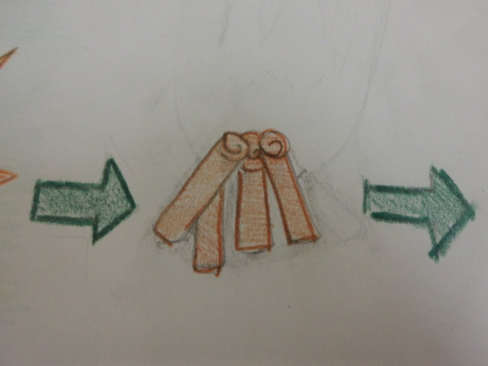
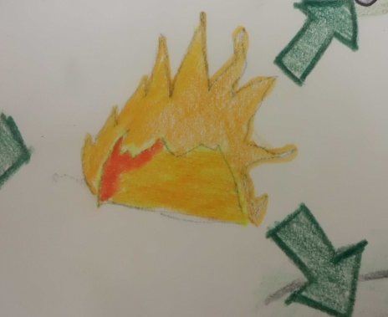
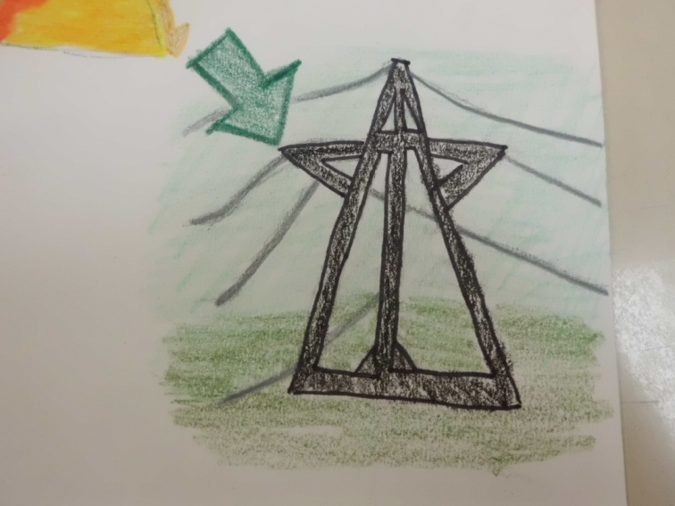
Mechanical
Solar
Thermical
Chemical
Electricity

Slide 10
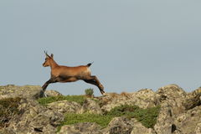
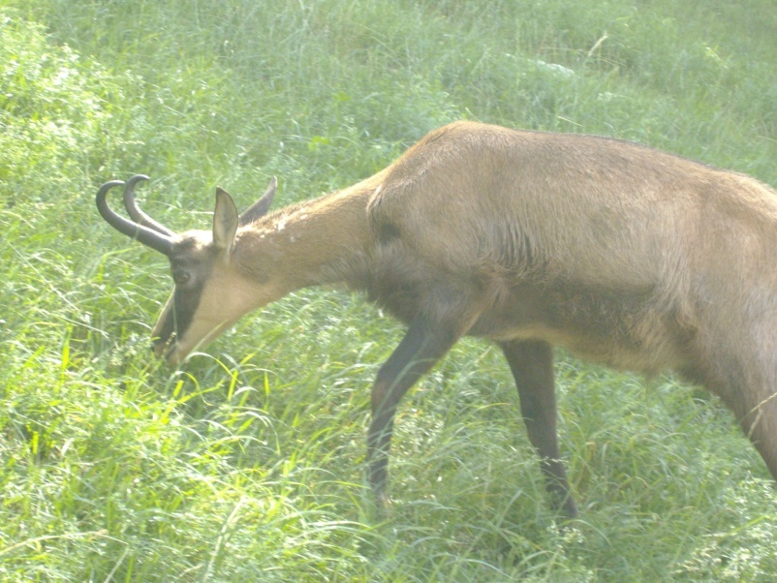

Slide 11
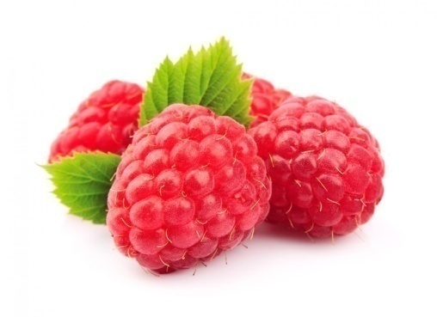
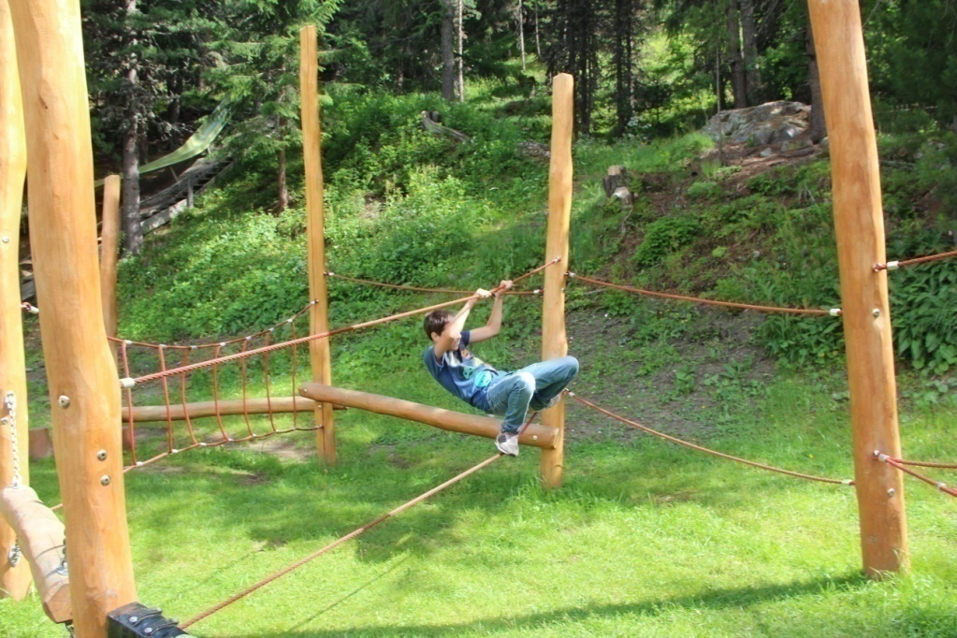

Slide 12
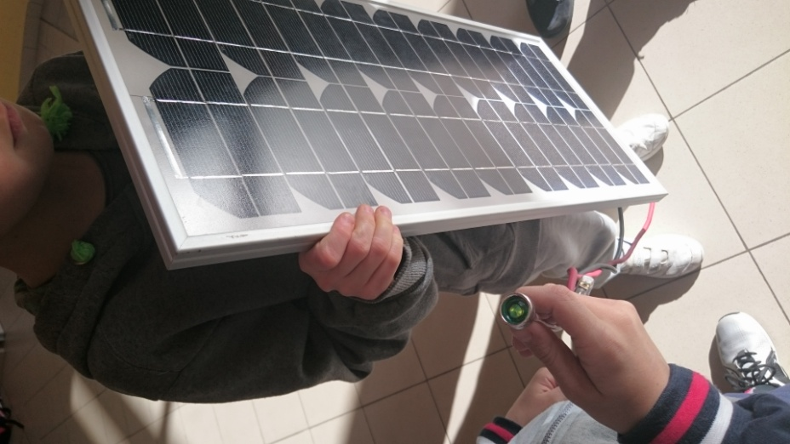

Slide 13
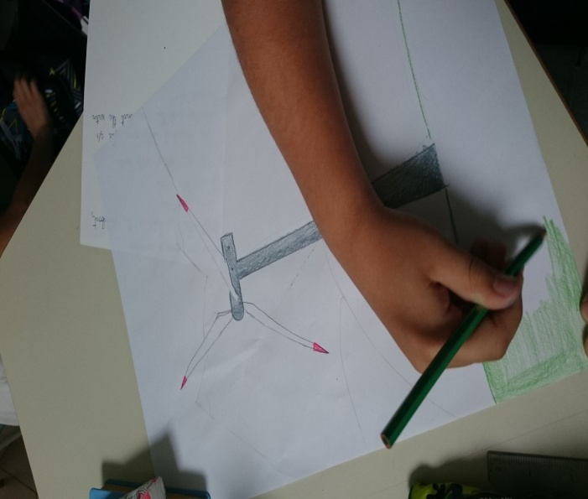
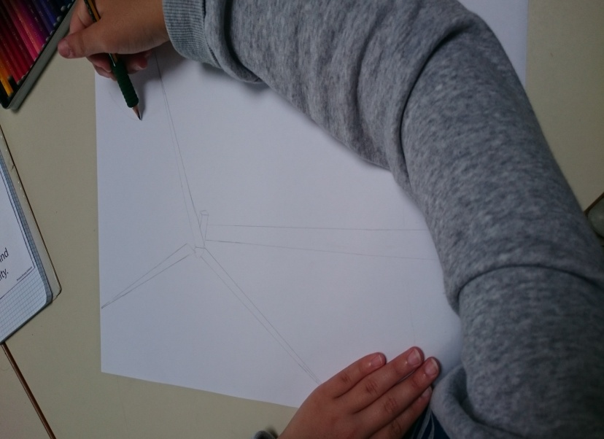

Slide 14
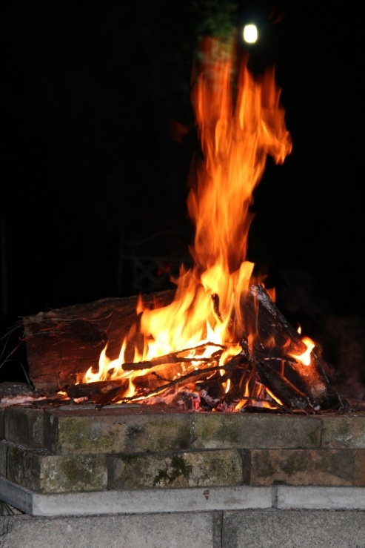
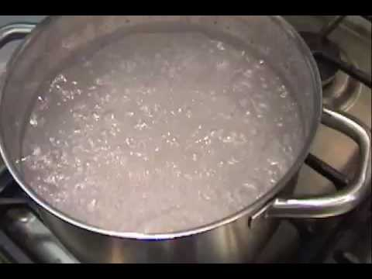

Slide 15
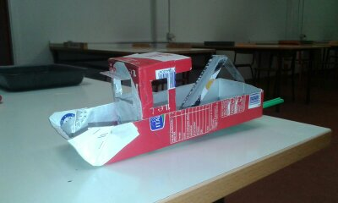
Now it’s your turn!
A pot pot steamboat

Slide 16
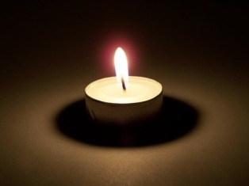
You need:
Milk carton
Coke can
Epoxy glue
Silicone caulk
Knife
Scissors
Tea light
Straws

Slide 17
Ask for help to your parents!!

Slide 18
Step 1: cut apart the soda can for the boiler

Slide 19
Step 2: start folding the aluminum “pocket” (the boiler) Step 3: cut the aluminum on the pattern Step 4: fold on the dashes lines of the pattern Step 5: measure and marks the straws

Slide 20
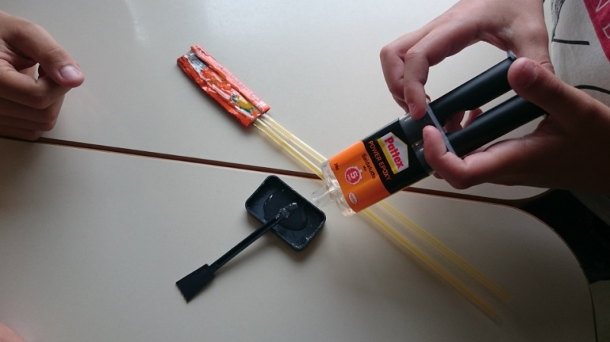
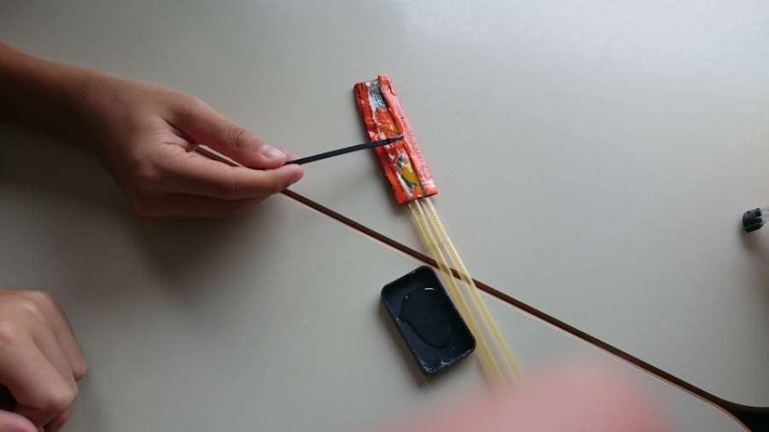
Step 6: start sealing the boiler
1
2
3

Slide 21
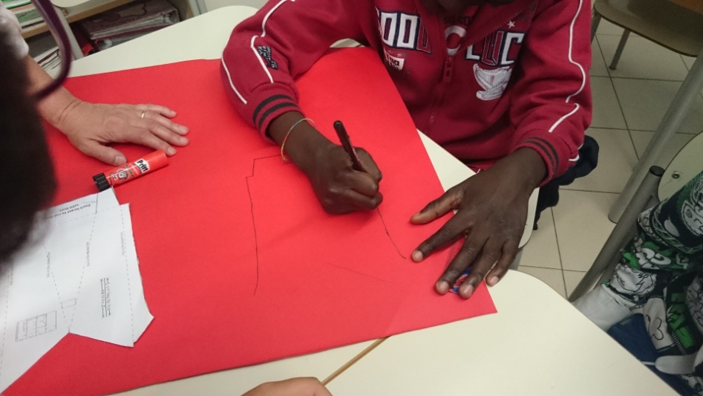
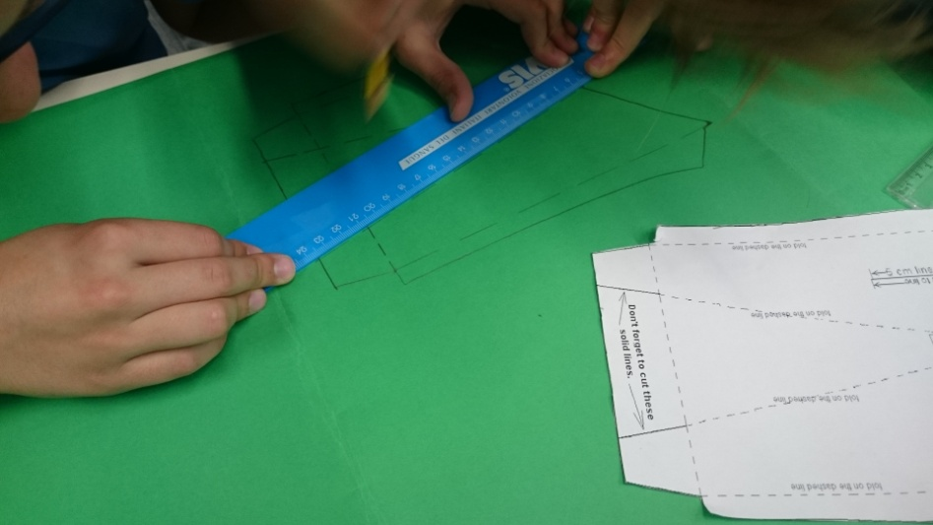
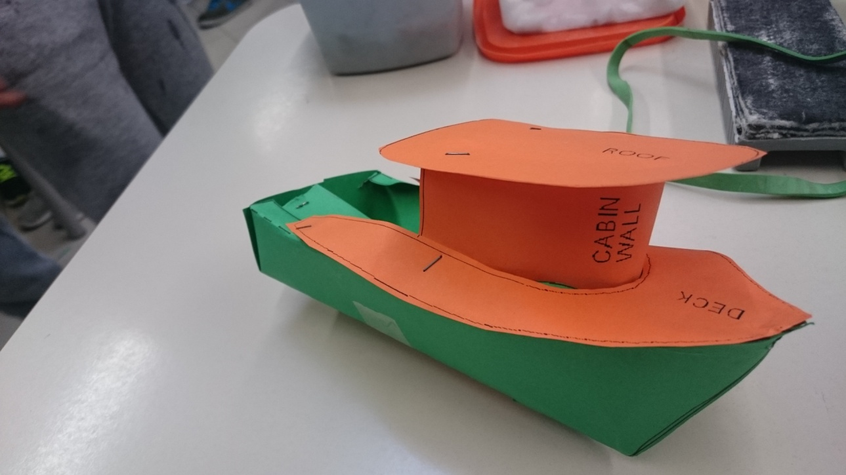
Step 7: make the boat body…. the project

Slide 22
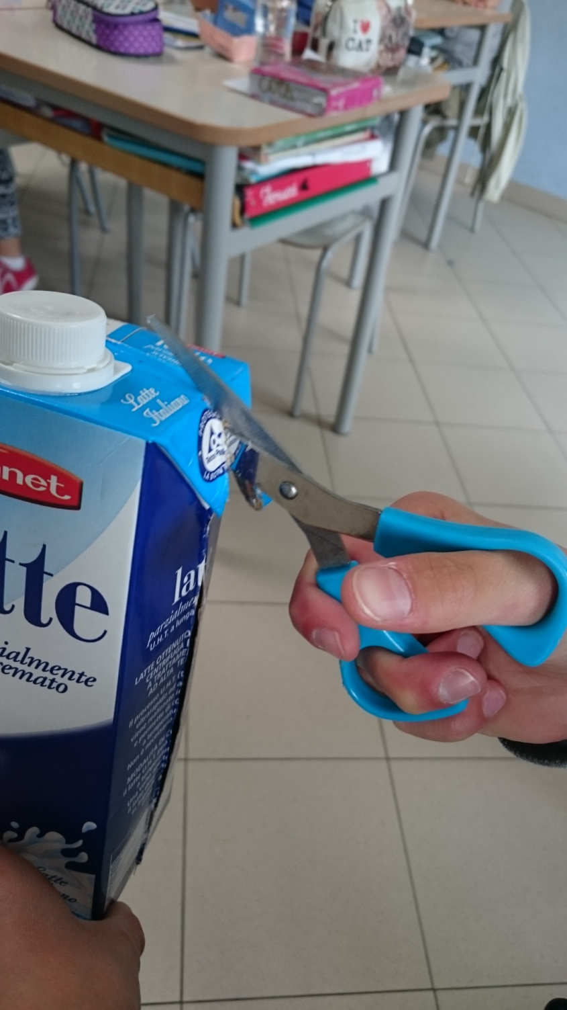
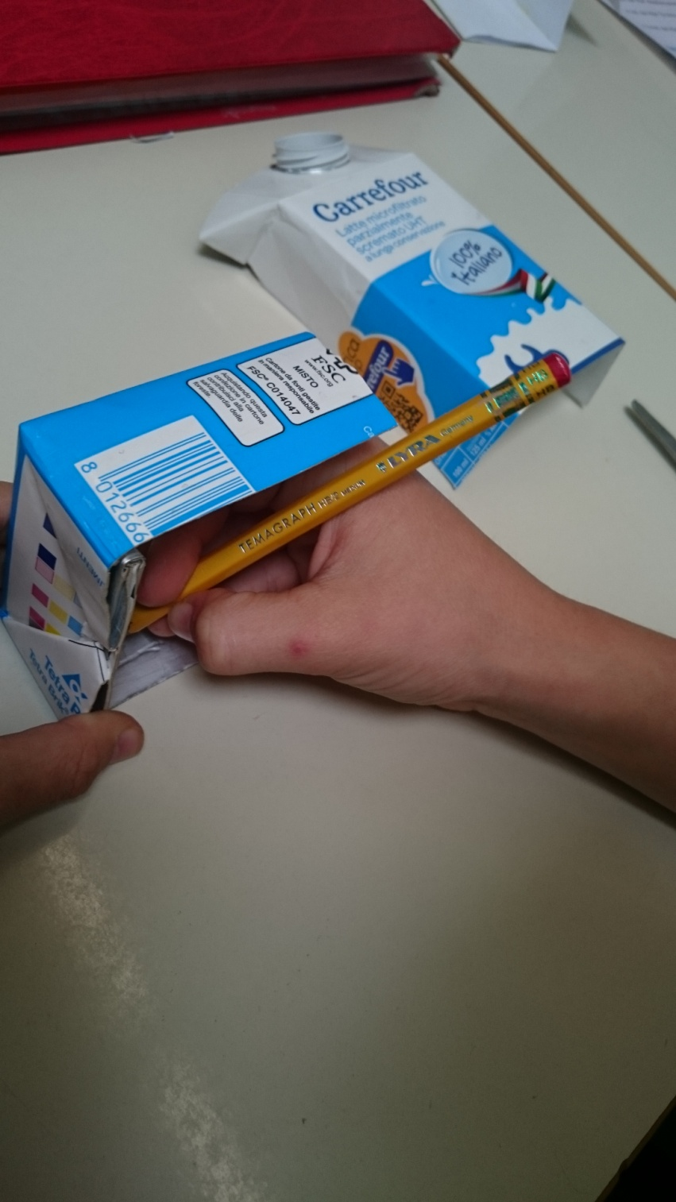
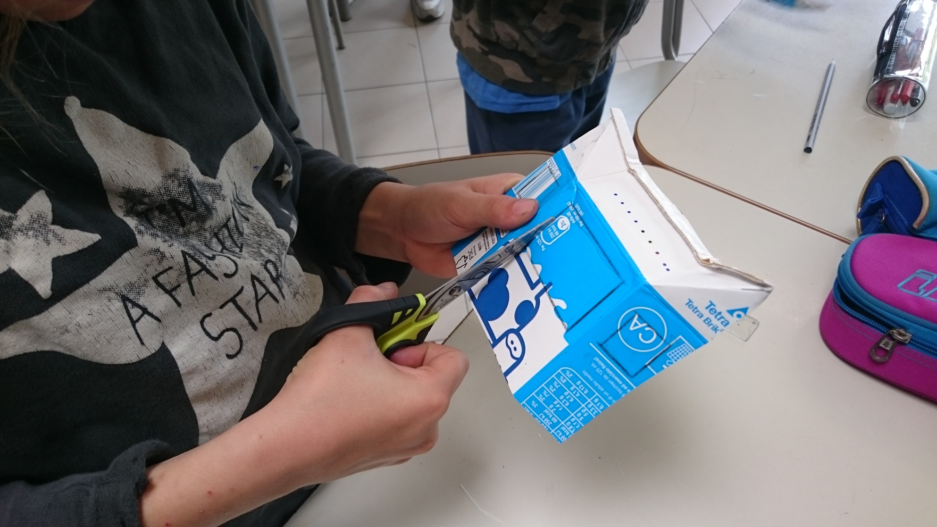
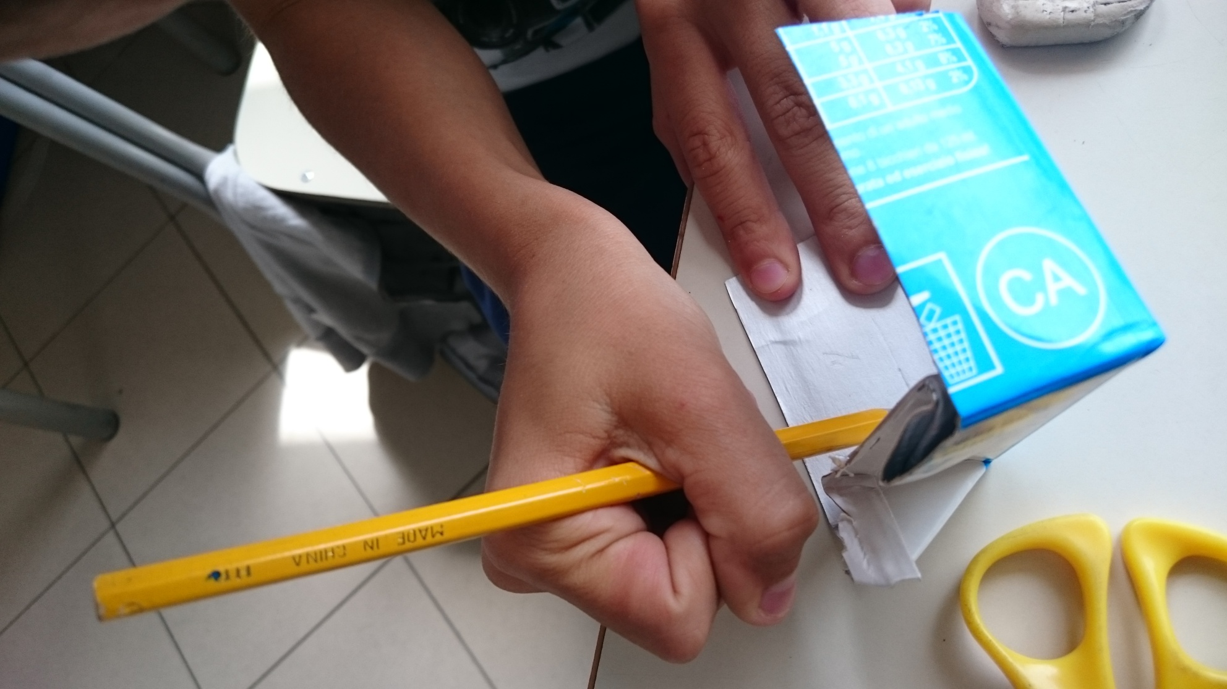

Slide 23
Step 8: seal the engine

Slide 24
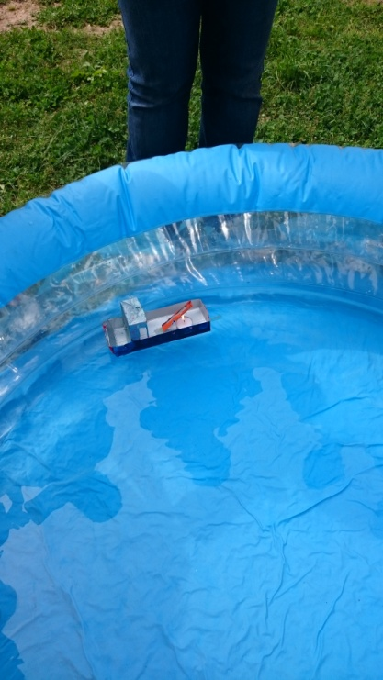
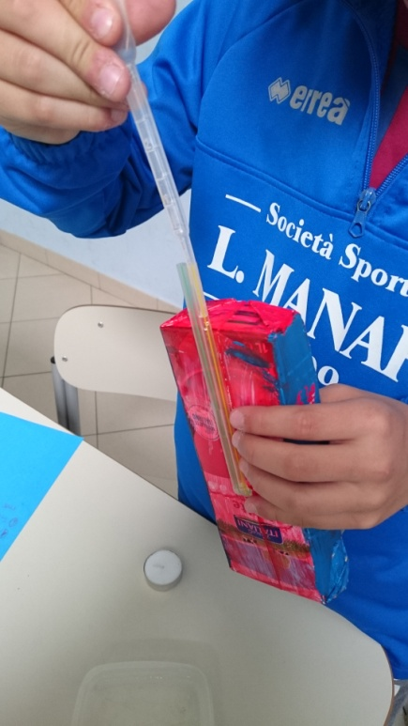
Step 9: wet and taste the boat
Don’t forget: light the tea light!!!

Slide 25
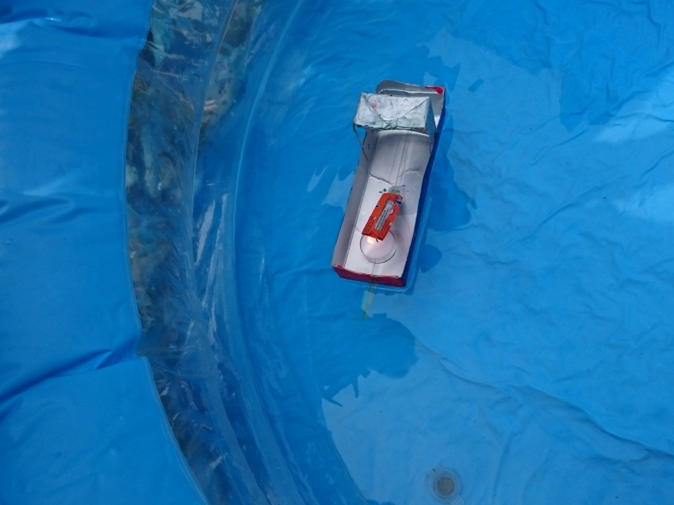
Enjoy yourself!

